Slide 1

Multimedia Data Management
Lecture 1 - Introduction
Fall 2022

Slide 2
Why do we need a database?

Slide 3

A Phonebook Application
How should we store the contacts?

Slide 4
A Phonebook Application
How should we store the contacts?
On a plain text file
May need delimiters, or attributes
How can we find a specific contact out of many?
How can we add another field to each contact?
Can we store everything in one file?

Slide 5
Drawbacks of Using File Systems
Data redundancy and inconsistency
Difficulty in accessing data
Data isolation
Integrity problems
Atomicity of updates
Concurrent access by multiple users
Security problems
Notes:
Duplication of information in different files
Need to write a new program to carry out each new task
Multiple files and formats
Integrity constraints (e.g., account balance > 0) become “buried” in program code rather than being stated explicitly. Hard to add new constraints or change existing ones
Failures may leave database in an inconsistent state with partial updates carried out. Example: Transfer of funds from one account to another should either complete or not happen at all
Concurrent access needed for performance, Uncontrolled concurrent accesses can lead to inconsistencies, Example: Two people reading a balance (say 100) and updating it by withdrawing money (say 50 each) at the same time
Hard to provide user access to some, but not all, data

Slide 6
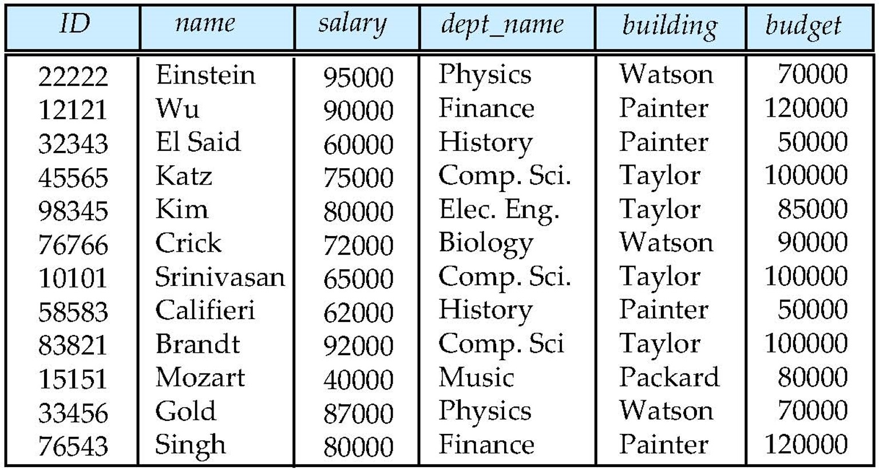


Data
Structured
Unstructured
Notes:
Structured data is data that has been predefined and formatted to a set structure before being placed in data storage, which is often referred to as schema-on-write. Easier to retrieve (access), applicable to more algorithms in machine learning. Harder to achieve, predefined purpose limits use.
Unstructured data is data stored in its native format and not processed until it is used, which is known as schema-on-read. It comes in a myriad of file formats, including email, social media posts, presentations, chats, IoT sensor data, and satellite imagery. More freedom, more data, harder to access, Requires data science expertise.
The internet revolution in late 90s sharply increased direct user access to databases. Developing web interfaces, making a verity of services and information available online.

Slide 7
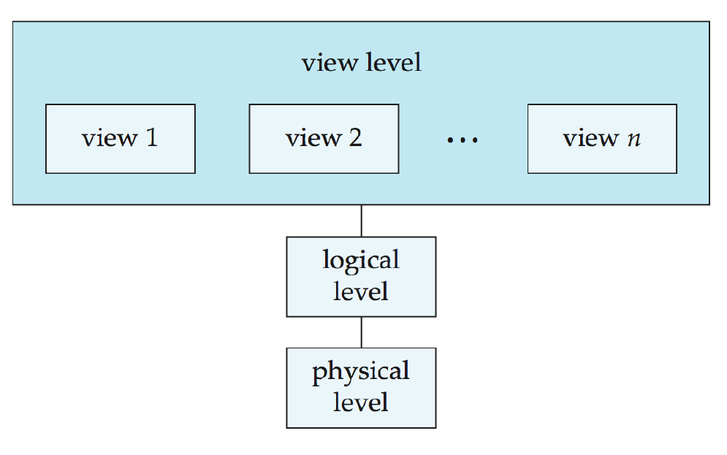
View of Data
An architecture for a database system:
Notes:
Physical level: describes how a record (e.g., instructor) is stored.
Logical level: describes data stored in database, and the relationships among the data.
View level: application programs hide details of data types. Views can also hide information (such as an employee’s salary) for security purposes.
One might think why we should have logical level and physical level. It’s because you don’t have to care about physical representation. It should be changed smoothly without

Slide 8

Database Management Systems (DBMS)
A database management system (DBMS) is system software for creating and managing databases. A DBMS makes it possible for end users to create, protect, read, update and delete data in a database. It needs to be easy to work with and still fast to operate.

Slide 9
Schema and Instances
Similar to types and variables in programming languages
Schema:
The overall physical/logical structure of the database
Instance:
The actual content of the database at a particular time
Notes:
We have data definition language (DDL) to describe metadata (data about data i.e. the constraints) and the result will be schema
We have data manipulation language (DML) to access and manipulate data. Also called query language.
Different types of access:
Retrieval
Insertion
Deletion
Modification
SQL is the most widely used commercial language to do all. (We have pure languages which focus on optimization)

Slide 10
Database Design
The process of designing the general structure of the database:
Business decision:
What attributes we should record on the database
Computer science decision:
What relation schemas we should have to distribute the data

Slide 11
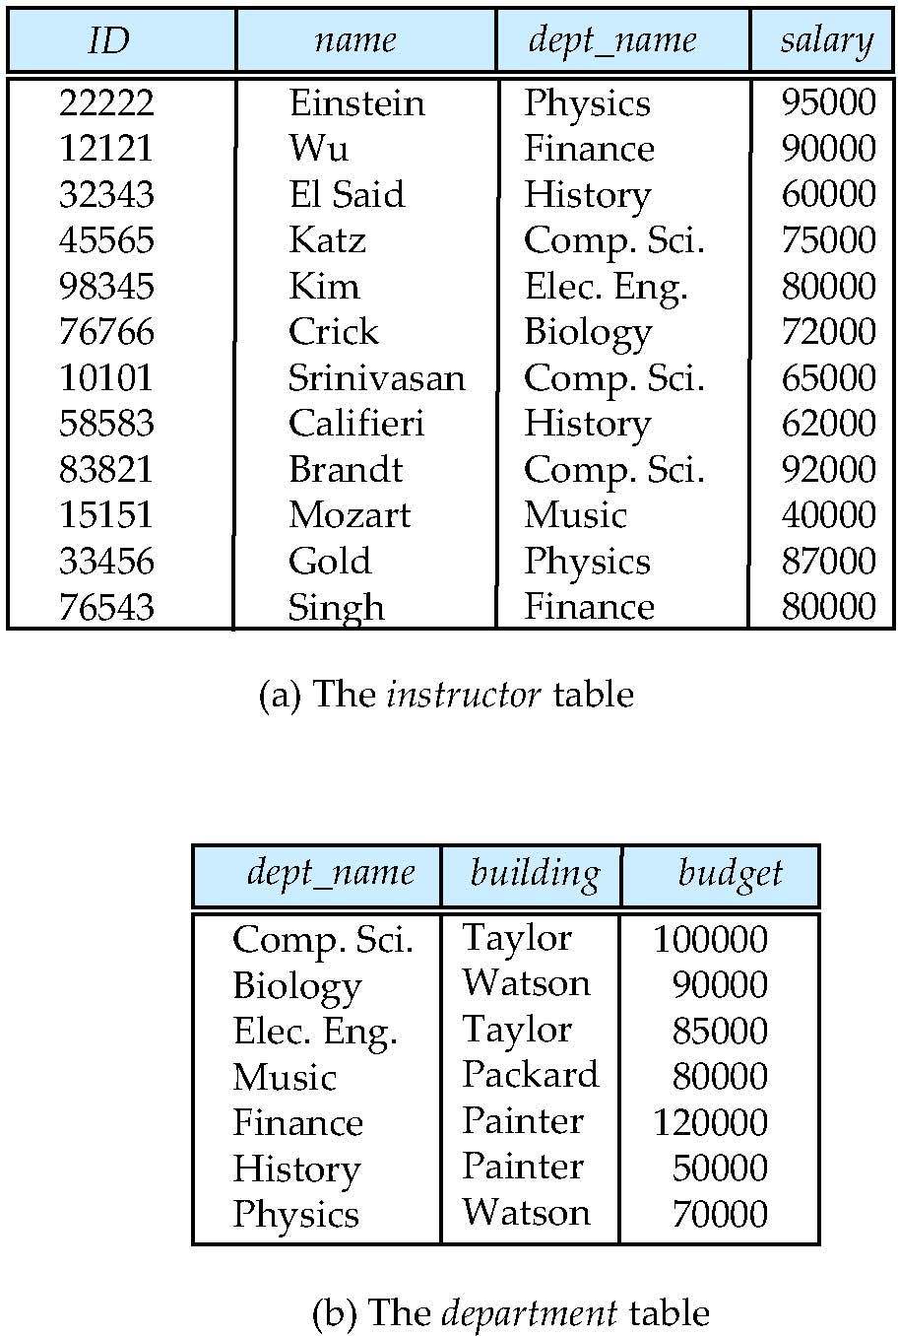
Database Design Example

Slide 12
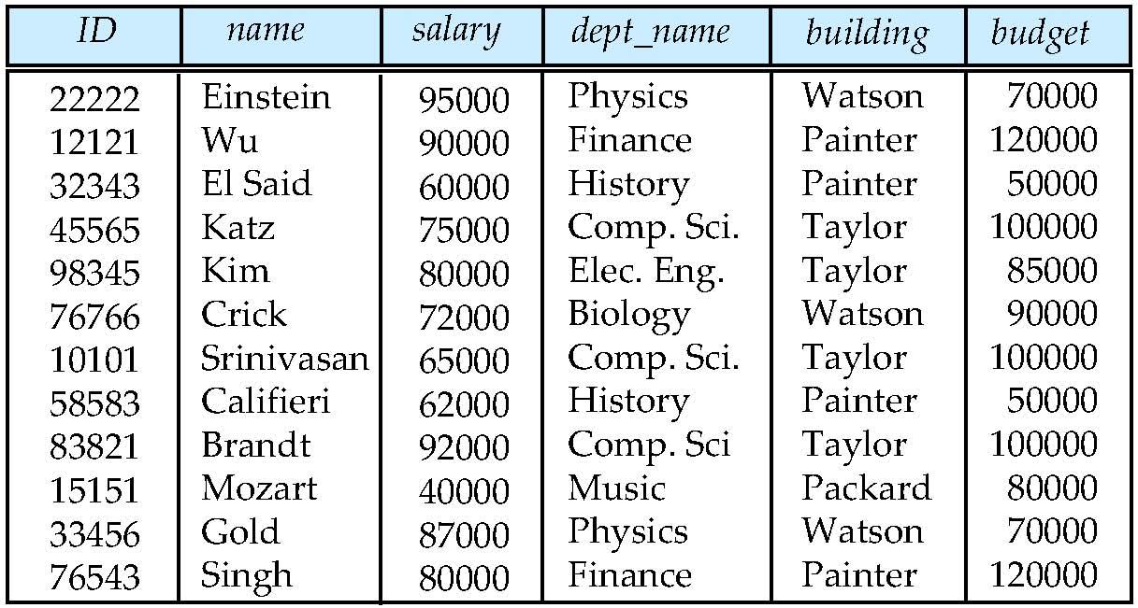
Database Design Example
Is there any problem with this relation?

Slide 13
Design Approaches
We need to come up with a methodology to ensure that each relation in the database is “good”
Entity-Relationship Model
Set a collection of entities and relationships
Represent them by a diagram
Normalization theory
Formal rules designed to protect the data, and eliminate redundancy, and inconsistent dependency.

Slide 14
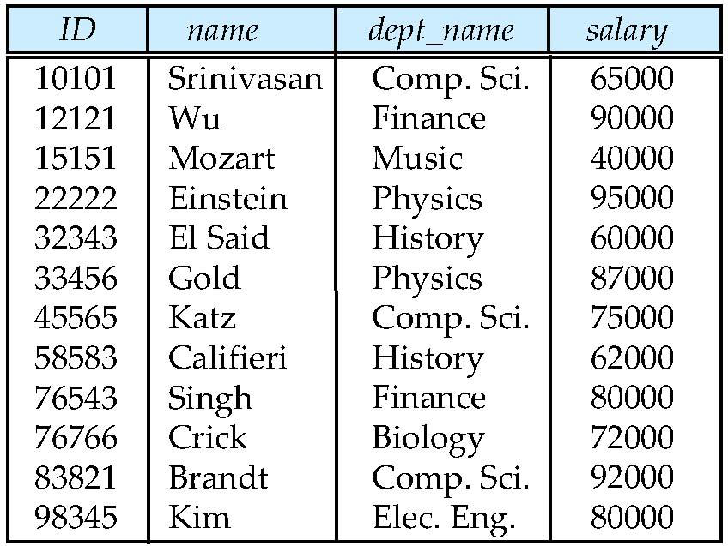
Relation Example
We have attributes on columns, and instances on rows.
Notes:
The set of allowed values for each attribute is called the domain of the attribute.
Attribute values are (normally) required to be atomic; that is, indivisible
The special value null is a member of every domain. Indicated that the value is “unknown”

Slide 15
What notation should we use to show our database formally?

Slide 16
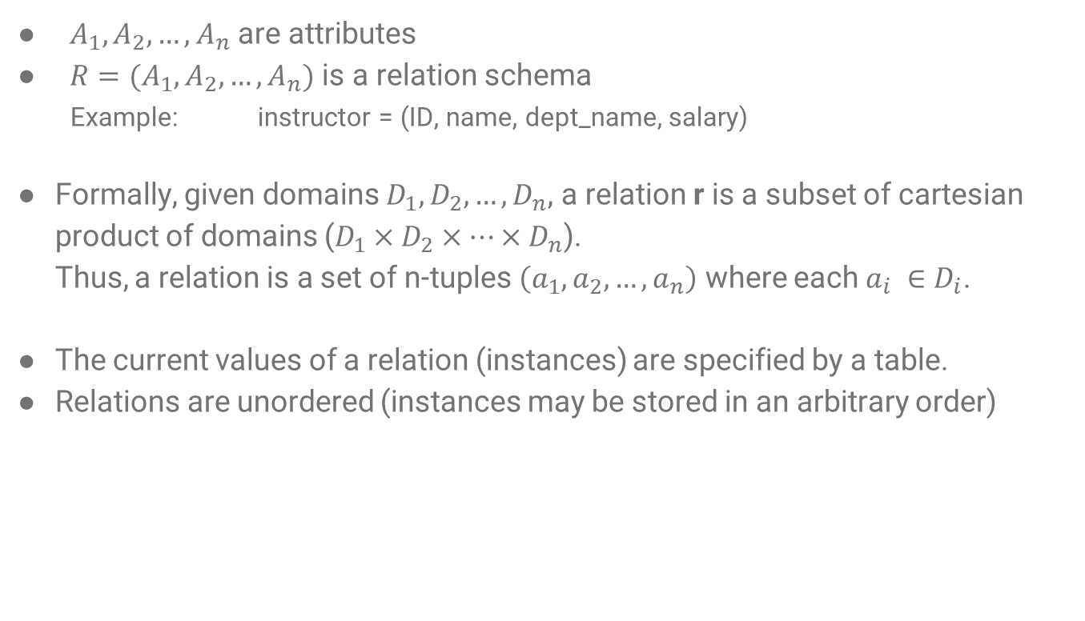
Relational Algebra
$A_{1},A_{2},…, A_{n}$ are attributes
$R=(A_{1},A_{2},…, A_{n})$ is a relation schema
Example: instructor = (ID, name, dept_name, salary)
Formally, given domains $D_{1},D_{2},…, D_{n}$, a relation r is a subset of cartesian product of domains ($D_{1}×D_{2}×…×D_{n}$).
Thus, a relation is a set of n-tuples $\left(a_{1},a_{2},…, a_{n}\right)$ where each $a_{i} ∈D_{i}$.
The current values of a relation (instances) are specified by a table.
Relations are unordered (instances may be stored in an arbitrary order)
Notes:
If someone’s salary changes, the schema won’t change but it’s the table that changes.

Slide 17
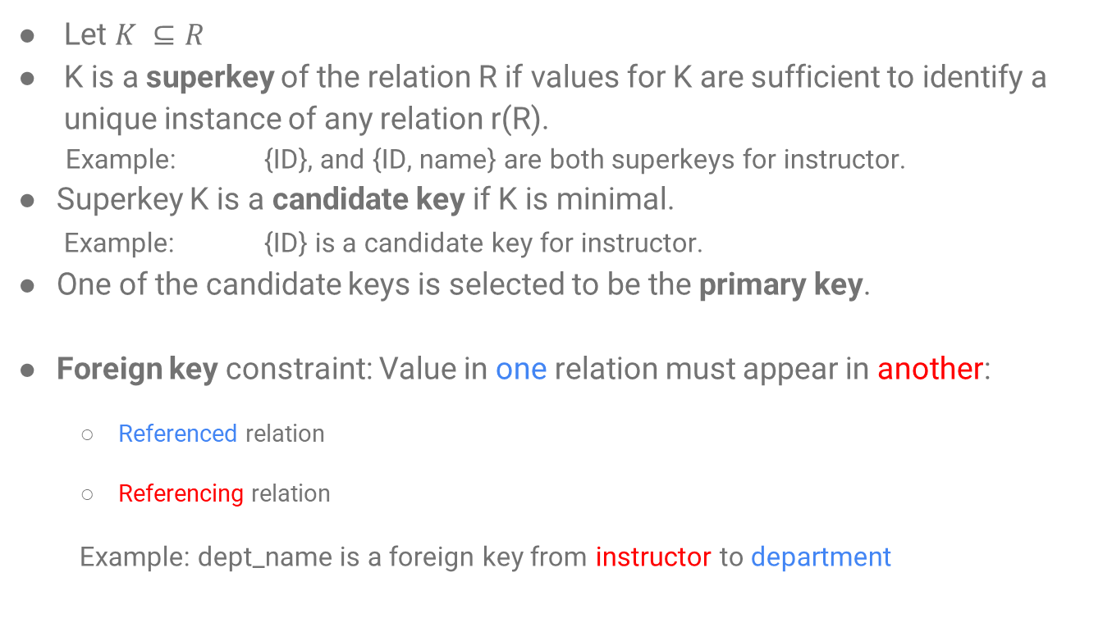
Keys
Let $K ⊆R$
K is a superkey of the relation R if values for K are sufficient to identify a unique instance of any relation r(R).
Example: {ID}, and {ID, name} are both superkeys for instructor.
Superkey K is a candidate key if K is minimal.
Example: {ID} is a candidate key for instructor.
One of the candidate keys is selected to be the primary key.
Foreign key constraint: Value in one relation must appear in another:
Referenced relation
Referencing relation
Example: dept_name is a foreign key from instructor to department

Slide 18
Big Picture

Slide 19

Select Operation
Select deals with rows.
Relation r:
$σ_{A=B ∧ D>5}(r)$

Slide 20
Select Operation
Select deals with rows.
Relation r:
$σ_{A=B ∧ D>5}(r)$

Slide 21

Project Operation
Project deals with columns.
Relation r:
$Π_{A, C}(r)$

Slide 22
Project Operation
Project deals with columns.
Relation r:
$Π_{A, C}(r)$

Slide 23

Union Operation
Relation r, s:
$r∪s$

Slide 24
Union Operation
Relation r, s:
$r∪s$

Slide 25

Set Difference Operation
Relation r, s:
$r−s$

Slide 26
Set Difference Operation
Relation r, s:
$r−s$

Slide 27

Intersection Operation
Relation r, s:
$r∩s$

Slide 28
Intersection Operation
Relation r, s:
$r∩s$

Slide 29

Cartesian Product Operation
Relation r, s:
$r×s$

Slide 30
Cartesian Product Operation
Relation r, s:
$r×s$

Slide 31

Alias Operation
It is simply renaming to avoid confusion.
Relation r
Renaming r as s: $ρ_{s}(r)$
$r×ρ_{s}(r)$
Notes:
We can use a composition of these operations as well

Slide 32

Natural Join Operation
Relation r, s:
$r⋈s$
$Π_{A, r.B, C, r.D, E}(σ_{r.B=s.B ∧ r.D=s.D }\left(r×s\right)))$

Slide 33
Natural Join Operation
Relation r, s:
$r⋈s$
$Π_{A, r.B, C, r.D, E}(σ_{r.B=s.B ∧ r.D=s.D }\left(r×s\right)))$

Slide 34
References
Database System Concepts - 6th edition (db-book.com)

